Slide 1
Extending Umbraco’s backoffice with custom editors
Leszek Porębski
leszek.porebski@intive.com
Wrocław, 22.02.2017

Slide 2
Agenda
Grid?
Grid Editors?
Custom Grid Editors?
But why…
Github link

Slide 3
Grid

Slide 4
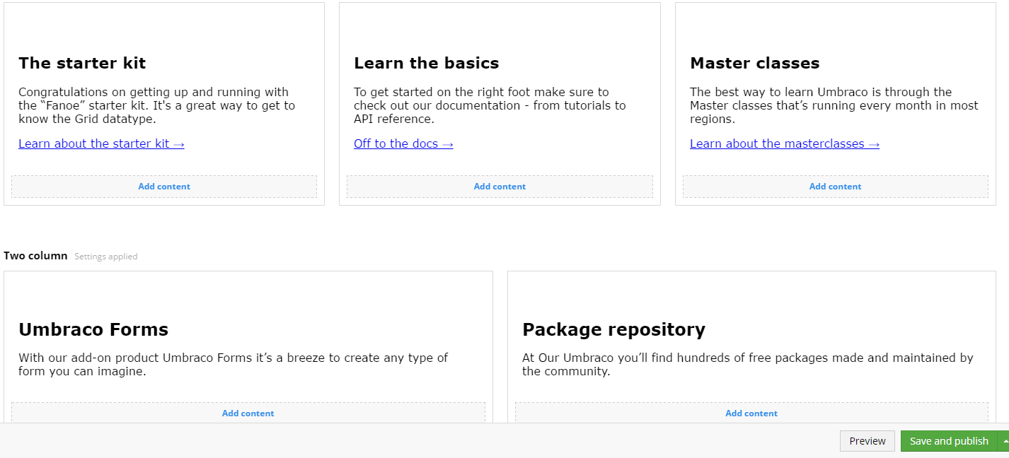
Grid

Slide 5
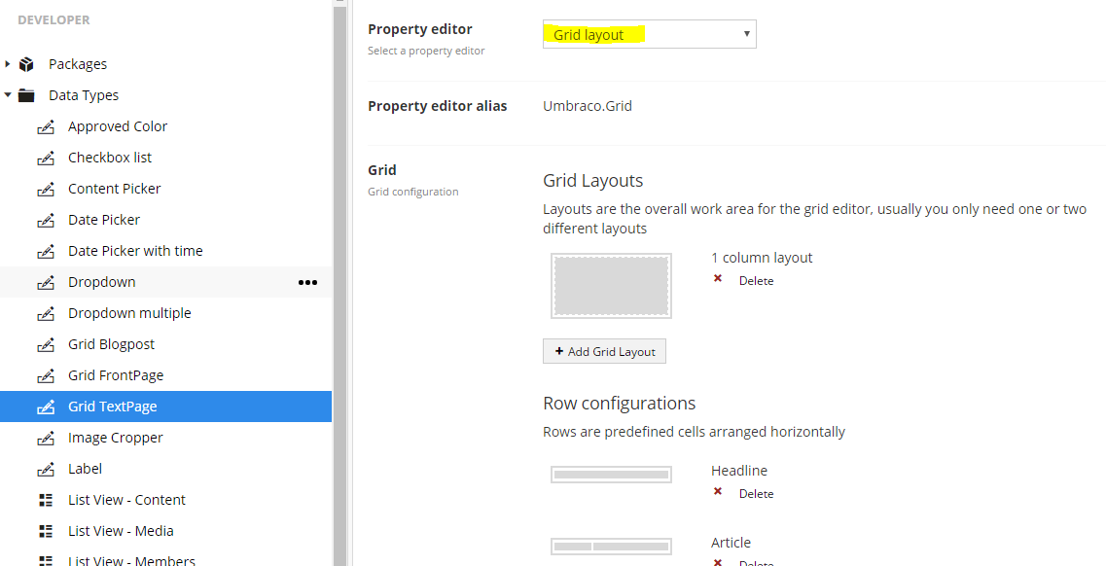
Grid
A property of some Data Type
A property editor of type „Grid layout”

Slide 6
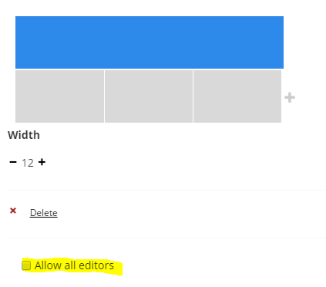
Grid
Grids can be customized in many ways…
RTE customization
Layouts definition
Rows definition
Cells customization

Slide 7
Grid Editors

Slide 8
Grid Editors
But before it, let’s see Grid configuration live…
Backoffice

Slide 9

Grid Editors
Ready to use controls for editing data

Slide 10
Grid Editors
Some fancy JavaScript
Configurable
/config/grid.editors.config.js
Extendable!

Slide 11
Grid Editors
Default editors:
RTE
Image
Macro
Embed
Headline
Quote

Slide 12
Custom Grid Editors

Slide 13

Custom Grid Editors
/config/grid.editors.config.js
Add new entry regarding your editor
Put you JS code somewhere in your project
Reference to your Grid Editors from this config file

Slide 14
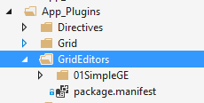
Custom Grid Editors
Put your code in /App_Plugins
Self-describe your plugin with package.manifest file
There’s a trap!
only one level deep manifests are discovered.
Notes:
Why this way?
It is easier to share plugins created this way

Slide 15
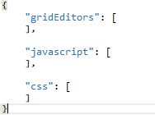
Custom Grid Editors
package.manifest
list of editors to register
list of referenced javascripts
list of referenced styles

Slide 16
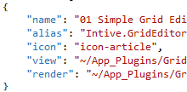
Custom Grid Editors
gridEditor definition
BackOffice display name
Internal alias
BackOffice icon
BackOffice View
EndUser View

Slide 17
Custom Grid Editors
Create a folder in App_Plugins
Make package.manifest file
Restart application so the plugins get rediscovered
Enable editors on elements of your choice

Slide 18
Let’s do this!

Slide 19

Custom Grid Editors
Renderer limitations/problems
Needs to inherit from Umbraco.Web.Mvc.UmbracoViewPage<dynamic>
No good place to store it except for the plugin’s directory
Cannot use partials (because of the dynamic type)
But there’s some hope!
We can still get around this problem by using helpers and strongly-typed models
We need to do it manually ☹

Slide 20
Custom Grid Editors
View’s pros
It’s an angular page
We have access to Bootstrap
View’s cons
It’s angular 1.1.5
It’s Bootstrap 2.3.1

Slide 21
Let’s do this!

Slide 22
Custom Grid Editors
How to access data?
$scope.control.value for grid editors
$scope.model.value for property editors
Bear in mind .value might and will be null at the beginning!

Slide 23
Custom Grid Editors
What can we use?
Umbraco provides you with UnderscoreJS
Don’t try to introduce Lodash in backoffice… it doesn’t turn out good ☹
What else can we do?
Well… it depends on our and our client’s imagination.
An editor is a regular angular’s controller
We can create modules, directives, constants etc.
Why struggle with ECMAScript 5? Use WebPack!

Slide 24
DEMO

Slide 25

Questions?
Grid?
Grid Editors?
Custom Grid Editors?
But why…
Github link

Slide 26
Thank You

